Slide 1
EFFECTIVE COMMUNICATION
AICPA PFP CONFERENCE
January 17-19, 2015
Harold Evensky
CFP, AIF

Slide 2
9 KEY POINTS OF COMMUNICATION

Slide 3
KEY # 1
THE “WHAT”
Philosophy
Process
People

Slide 4
PHILOSOPHY
We believe …
  Cash Flow not Dividends & Interest
  Capital Needs with Reasonable Assumptions
  Goals Based Planning
  Tax Constraints
  Efficient Market Hypothesis

Slide 5
PHILOSOPHY
We believe in…
  Value
  Active AND Passive
  Asset Allocation largest determinate of LT Return
  Future Markets and Returns will be Modest
  A Written Investment Policy

Slide 6
PROCESS
We are fee-only and therefore minimize conflicts
We work in teams
We use goals-based capital needs analysis with forward looking assumptions
We distinguish between risk tolerance, risk capacity & risk need.
We use the financial planning process

Slide 7
PEOPLE
We believe in Credentials – all advisors hold the CFP designation
Our practitioners adhere to a Code of Ethics & a Fiduciary Relationship
We believe in staying current with academic research

Slide 8
KEY #2
ESTABLISHING VALUE
The Creak and the Carpenter…

Slide 9
KEY #3 - THE “WHO”
THE PUBLIC
The Public Relations “B’s”
  Be Aware
  Be Available
  Be Interesting &Controversial
  Be Dependable
  Be Professional
  Be a Resource
  Be Proactive
  Be Patient

Slide 10
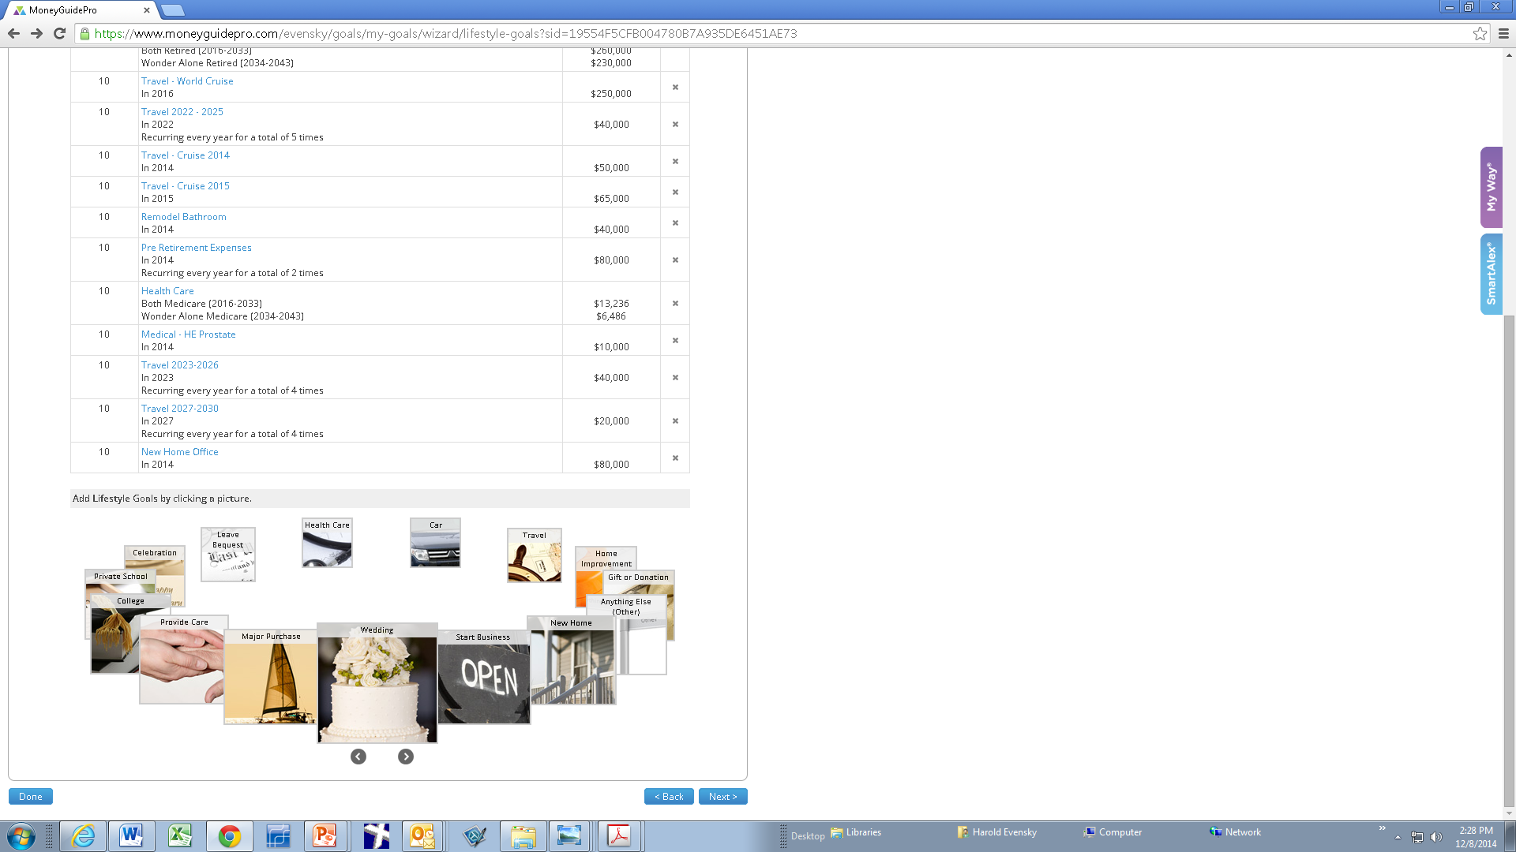
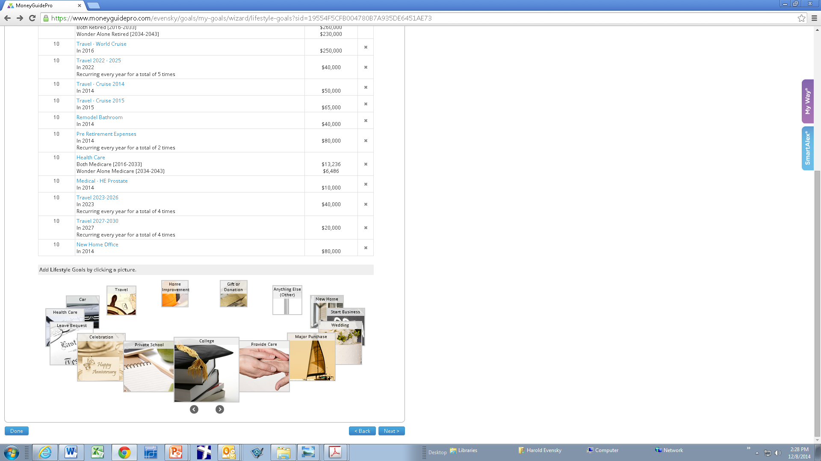
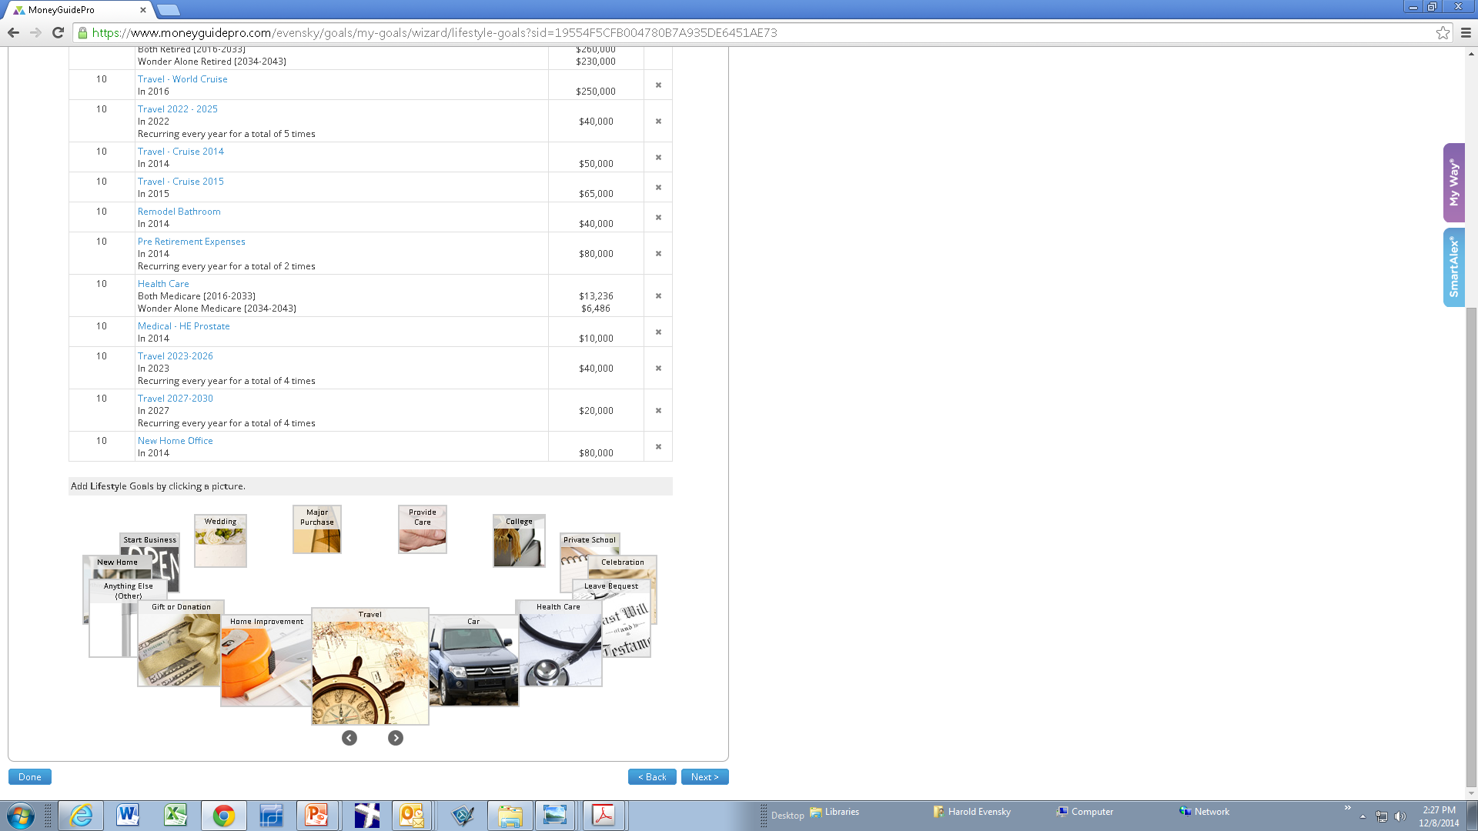
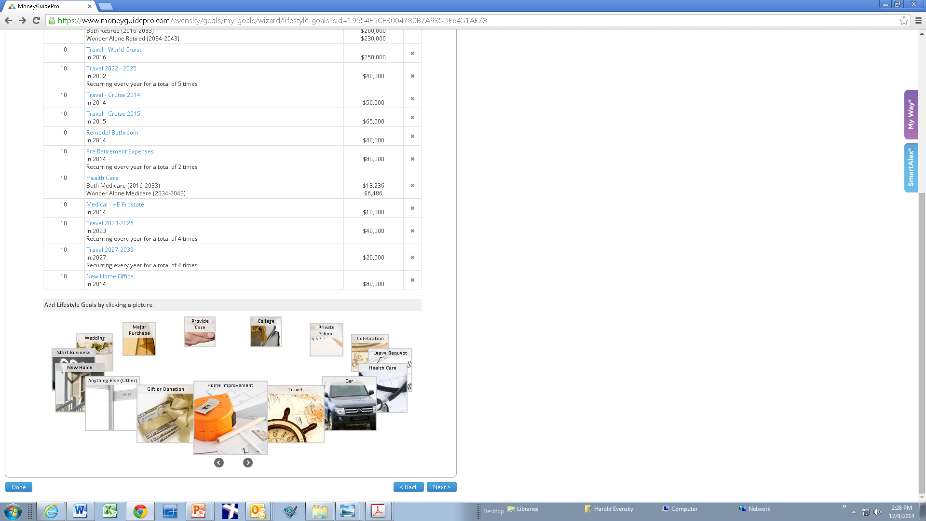
KEY #4 – THE “WHO”
THE PROSPECT
What Brings You Here?
Tell me About Yourself…
Let’s Have Fun. Let’s Play Cards!

Slide 11
KEY #5 – THE “WHO”
THE CLIENT
PROACTIVE
Responsive
Reinforcement Through Frequent, but Not Overwhelming Communications

Slide 12
KEY #6 - THE “HOW”
BEHAVIORAL FINANCE TECHNIQUES
In Classical Finance Investors are Rational; In Behavioral Finance Investors are Normal, but Predictable

Slide 13
HEURISTICS
MENTAL SHORTCUTS

Slide 14
OVERCONFIDENCE
COMPARED TO OTHERS IN THIS SESSION, ARE YOU:
AN ABOVE AVERAGE ADVISOR?

Slide 15
REPRESENTATIVENESS
IF IT LOOKS LIKE A………………...

Slide 16
REPRESENTATIVENESS
HHTHTTTHTH
TTTTTTTTTT

Slide 17
REPRESENTATIVENESS
MORNINGSTAR GAVE THIS FUND...
IT MUST BE GOOD

Slide 18
MENTAL ACCOUNTING
HOT TECH STOCK - IFGOVT. SAYS GO…90%
PROTOTYPE GOOD……………………….. 90%
REGIONAL TEST OK………………………..90%
NATIONAL ROLLOUT………................…...90%
DO YOU INVEST?
66%

Slide 19
MENTAL MATHEMATICS
LAST YEAR, I MADE 80%
THIS YEAR, I LOST 60%
MENTAL MATH
AHEAD 20%
THEREFORE I’M
BEHIND 28%
REALITY

Slide 20

KEY # 7 – THE “HOW”
FRAMING
Which would you rather have?
90% Fat Free
10% Fat

Slide 21
WOULD YOU BUY THAT STOCK TODAY?

Slide 22
FRAMING
NAME THE TOP 10
BASEBALL PLAYERS
PAINTERS
MOVIE ACTORS
DRESS DESIGNERS
MONEY MANAGERS

Slide 23
FRAMING
CONTAGEOUS ENTHUSIASM
WHAT COULD GO WRONG?

Slide 24
FRAMING
IF YOU ARE RIGHT, YOU’LL MAKE A HANDSOME PROFIT.
IF YOU ARE WRONG, YOU’LL NEED TO WORK 3 MORE YEARS.

Slide 25
FRAMING
CONFUSING CERTAINTY & SAFETY

Slide 26
FRAMING
RISK AVERSE VS. LOSS AVERSE

Slide 27


Slide 28
KEY # 7 – THE “HOW”
EDUCATION & EMPOWERMENT
 |  | Most |  |  |  | Least
Capital Preservation | 6 | 5 | 4 | 3 | 2 | 1
Growth | 6 | 5 | 4 | 3 | 2 | 1
Low Principal Volatility* | 6 | 5 | 4 | 3 | 2 | 1
Inflation Protection | 6 | 5 | 4 | 3 | 2 | 1
Current Cash Flow | 6 | 5 | 4 | 3 | 2 | 1
Aggressive Growth | 6 | 5 | 4 | 3 | 2 | 1
GOTCHA!

Slide 29
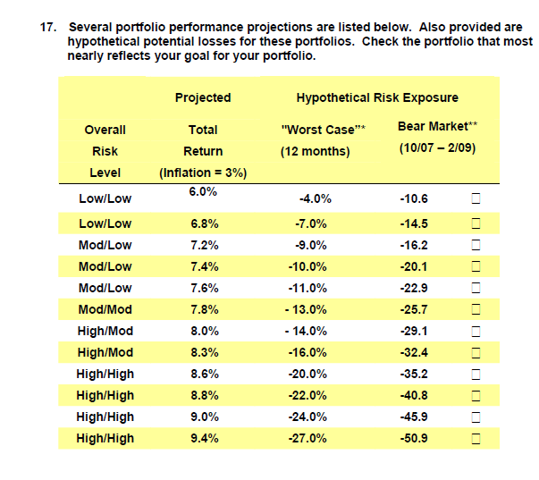
REALITY

Slide 30
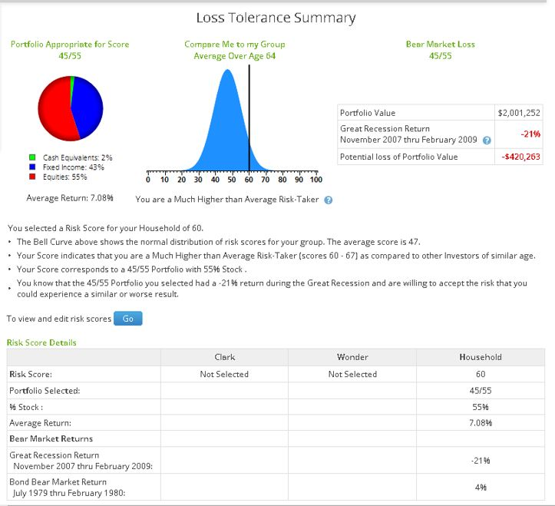
REALITY

Slide 31
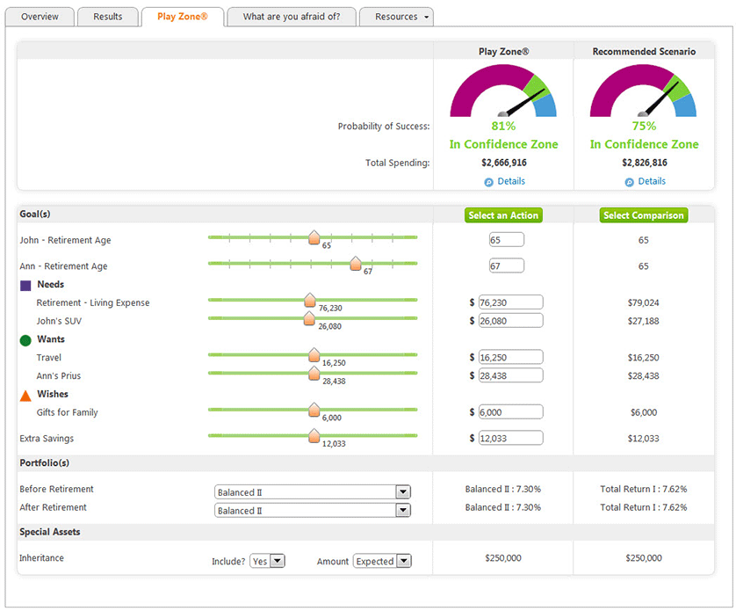
KEY #8 Interactivity
WANT TO CHANGE?
Key # 8 Engage the Client

Slide 32
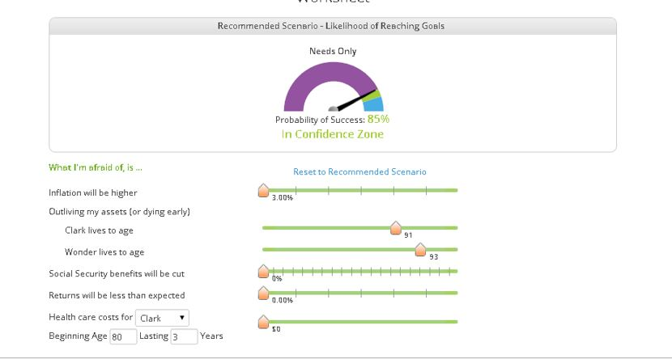
WHAT KEEPS YOU AWAKE?

Slide 33
THE E&K CASH FLOW STRATEGY
CASH FLOW RESERVE
THE TOTAL PORTFOLIO
THE INVESTMENT PORTFOLIO

Slide 34
CASH FLOW RESERVE
1 YEARS CASH FLOW
5 YEARS LUMP SUM
BALANCE OF PORTFOLIO
REINVESTMENT OF ALL INTEREST & DIVIDENDS
ADJUSTED AS NECESSARY FOR OPPORTUNITY COSTS
THE INVESTMENT PORTFOLIO

Slide 35
CASH FLOW RESERVE
Rebalance
Refill
Regular Monthly Payments
the “PAY CHECK”
THE INVESTMENT PORTFOLIO
PERSONAL CHECKING ACCOUNT

Slide 36
BAD NEWS IS GOOD NEWS
GOOD NEWS IS BAD NEWS
KEY #9 – THE “HOW”
ACKNOWLEDGE THE ELEPHANT

Slide 37
BAD NEWS
ACKNOWLEDGE
Frame Reality
Long Term View
Outline consequences of change at this point
What might go right

Slide 38
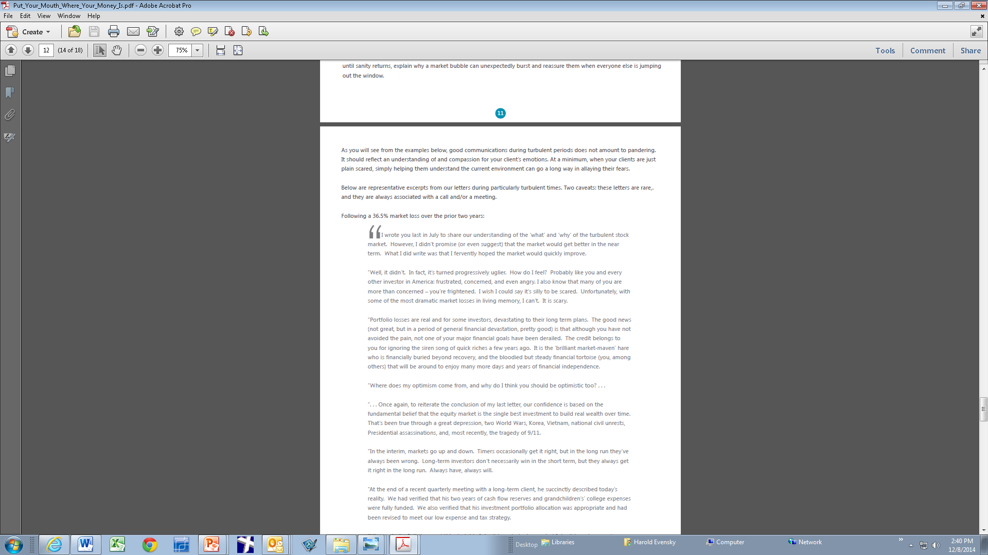
FOLLOWING A 36 ½% LOSS IN LESS THAN TWO YEARS

Slide 39
GOOD NEWS
Outlining consequences of change at this point
What might go wrong
TEMPER THEIR ENTHUSIASM

Slide 40
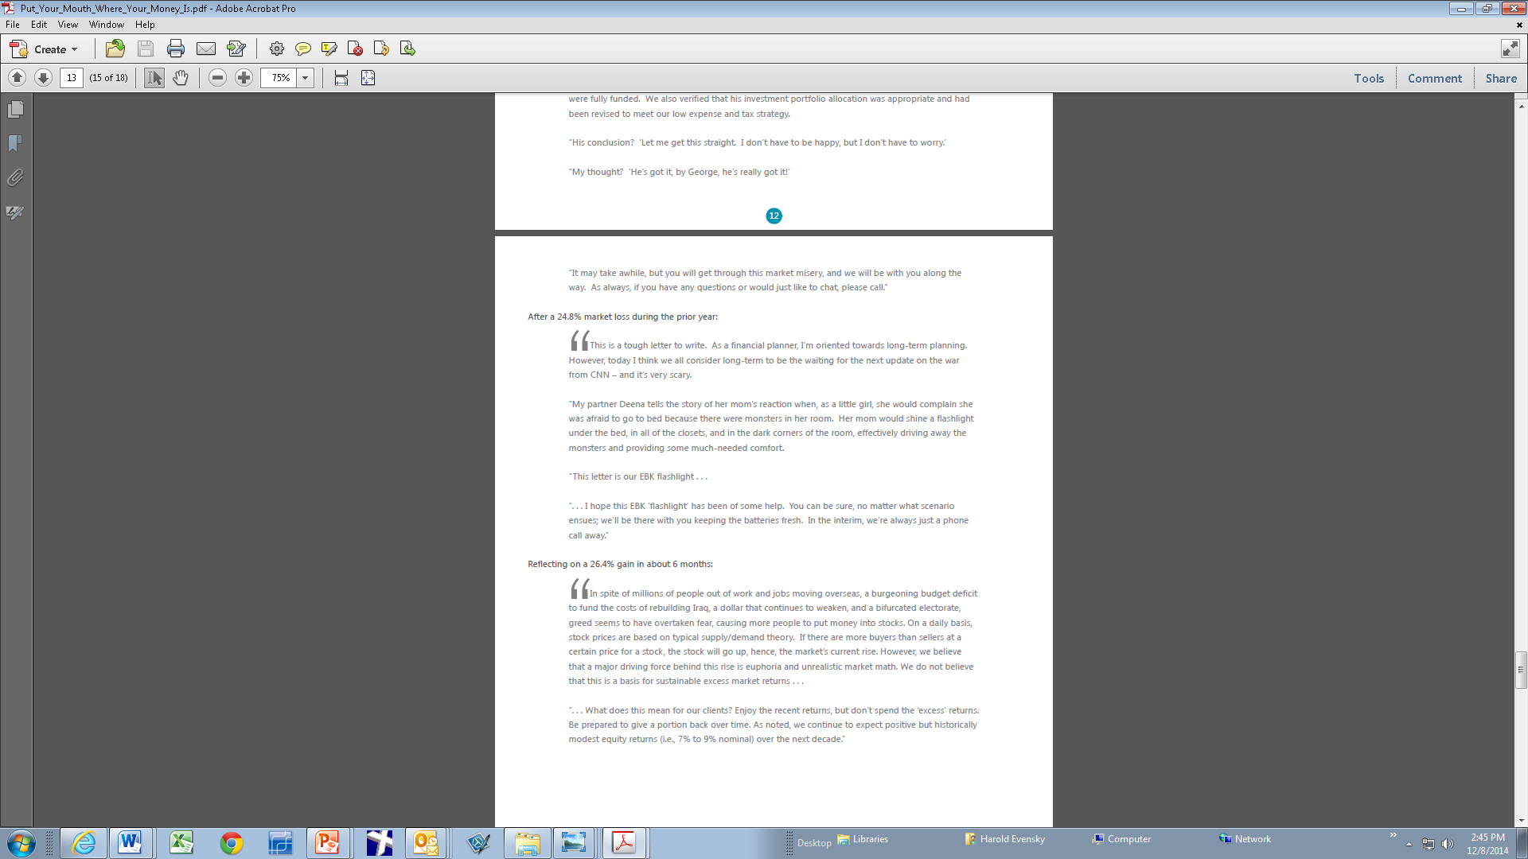
FOLLOWING A 26.4% GAIN IN 6 MONTHS

Slide 41
TOP
TAKEAWAYS
The 3 P’s
Value vs. Performance
PR – Don’t Forget the Public
Use Behavioral Finance Techniques and Framing
Educate & Empower
Remember What It’s All About

